Slide 1
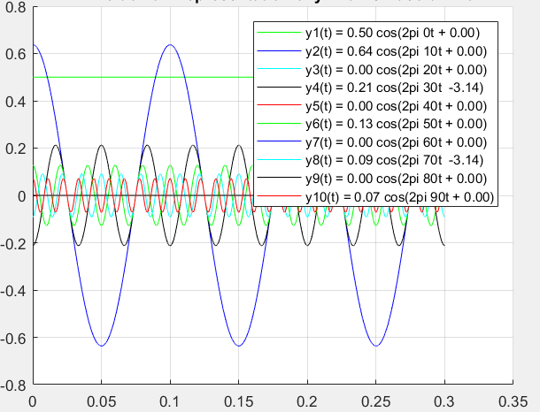
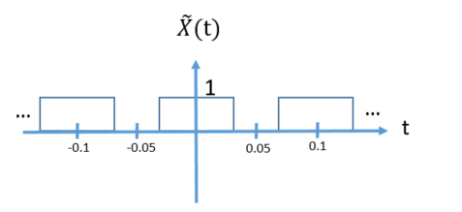
Q1i)What is Fourier Analysis?
It decompose original signal into sinusoids(complex exponentials with k harmonics of Fundamental Angular Frequency Ω).
Original Signal
Analysis

Slide 2




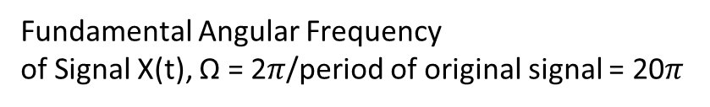
Decomposed Signal x(t) of k^{th} harmonic sinusoids
Fundamental Angular Frequency
of Signal X(t), Ω = 2$π$/period of original signal = 20$π$
DC component of Original Signal, K = 0
1st Harmonic where k = 1, Ω = 1*20$π$
2nd Harmonic where k = 2, Ω = 2*20$π$
.
.
.
10th Harmonic where k = 10, Ω = 10*20$π$
.
.
.
50th Harmonic where k = 100, Ω = 100*20$π$

Slide 3
Q1ii)What is Fourier Synthesis?
It reconstructs original signal with sum of sinusoids(complex exponentials with k harmonics of Fundamental Angular Frequency Ω).
Original Signal
Synthesis

Slide 4
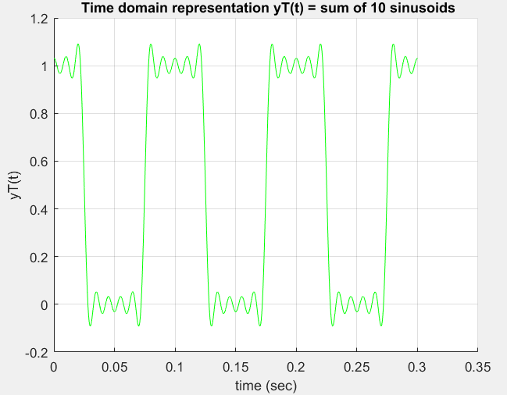
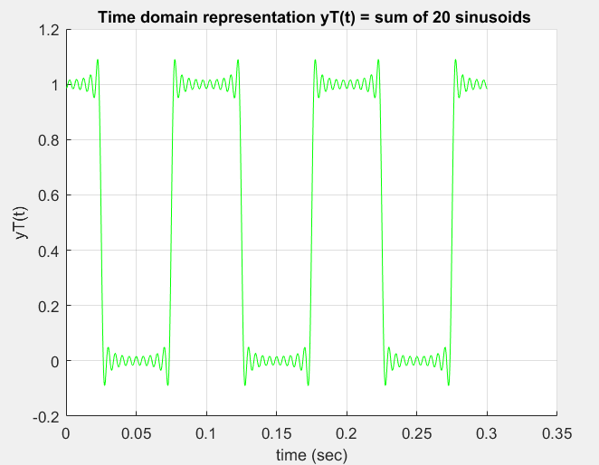
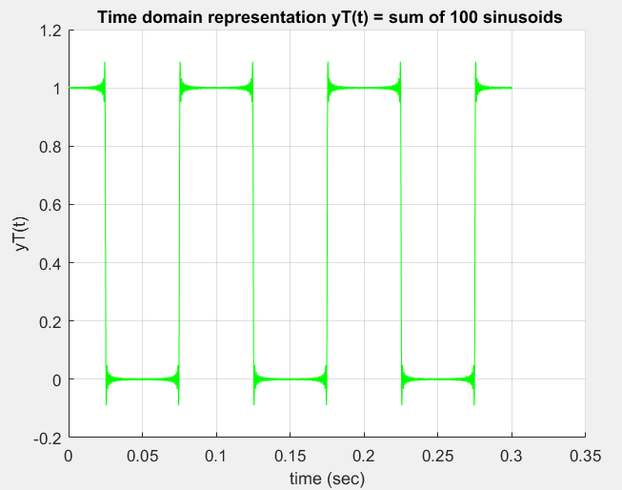
Sum of k^{th} harmonic of sinusoids
K=0 to 10
K=0 to 20
Original Signal
K=0 to 100
As the amount of harmonic are increases, the reconstruction of the original signal is more accurate.
Visualization of sum of sinusoids:
Reference: https://www.youtube.com/watch?v=nuzA75DpSuw
Time : 35:30

Slide 5
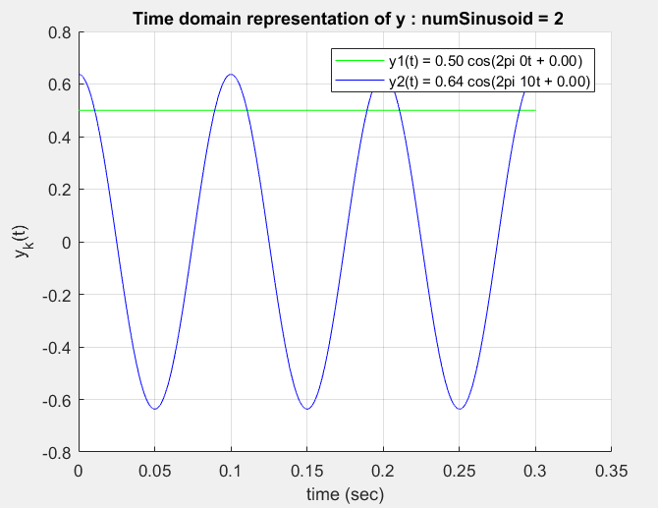
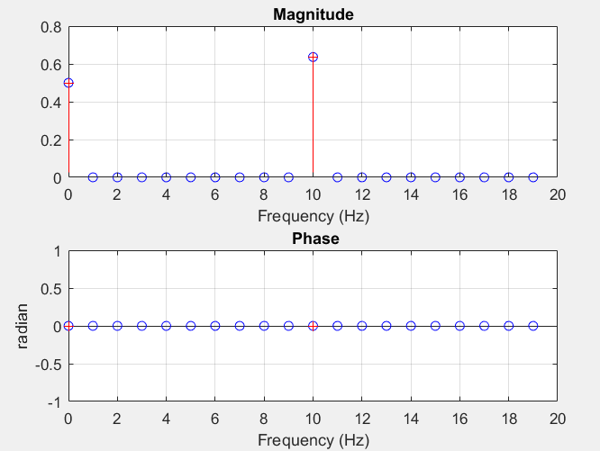
1b) Magnitude and Phase representation Time VS Frequency
0th harmonic(Dc component) + 1st Harmonic
0th Harmonic
1st Harmonic
Each harmonic can be represented in exponential form = |magnitude| e ^ (k*Fundamental Angular Frequency + Phase)

Slide 6
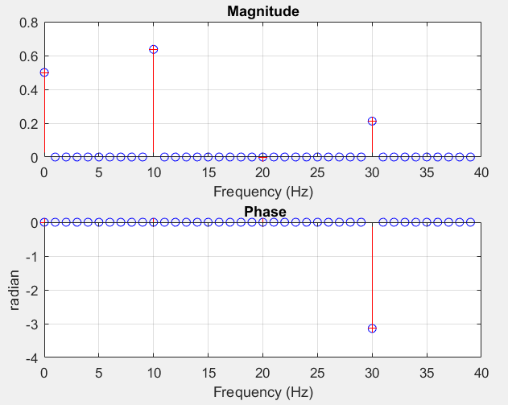
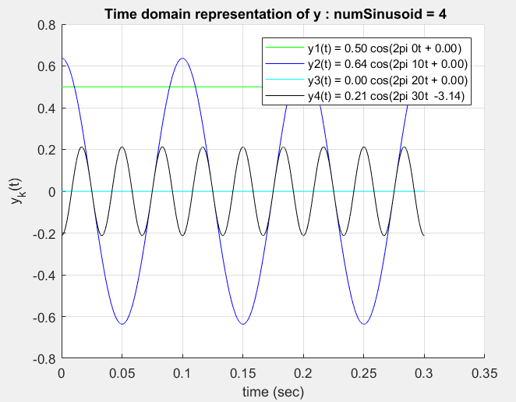
Magnitude and Phase representation Time VS Frequency
0th harmonic(Dc component) + 1st Harmonic + 2nd Harmonic + 3rd Harmonic
0th Harmonic
1st Harmonic
2nd Harmonic
3rd Harmonic
Each harmonic can be represented in exponential form = |magnitude| e ^ (k*Fundamental Angular Frequency + Phase)
Notes:
Each harmonic can be represented in exponential form = |magnitude| e ^ (k*Fundamental Angular Frequency + Phase)

